Slide 1
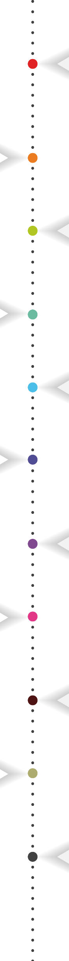



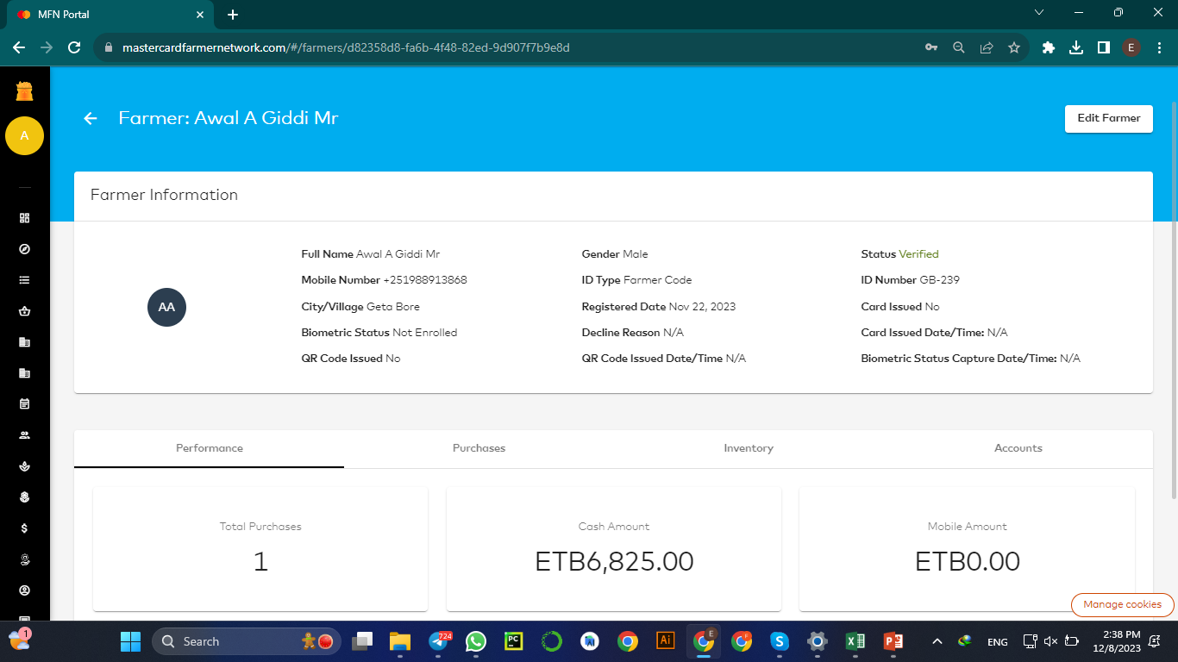
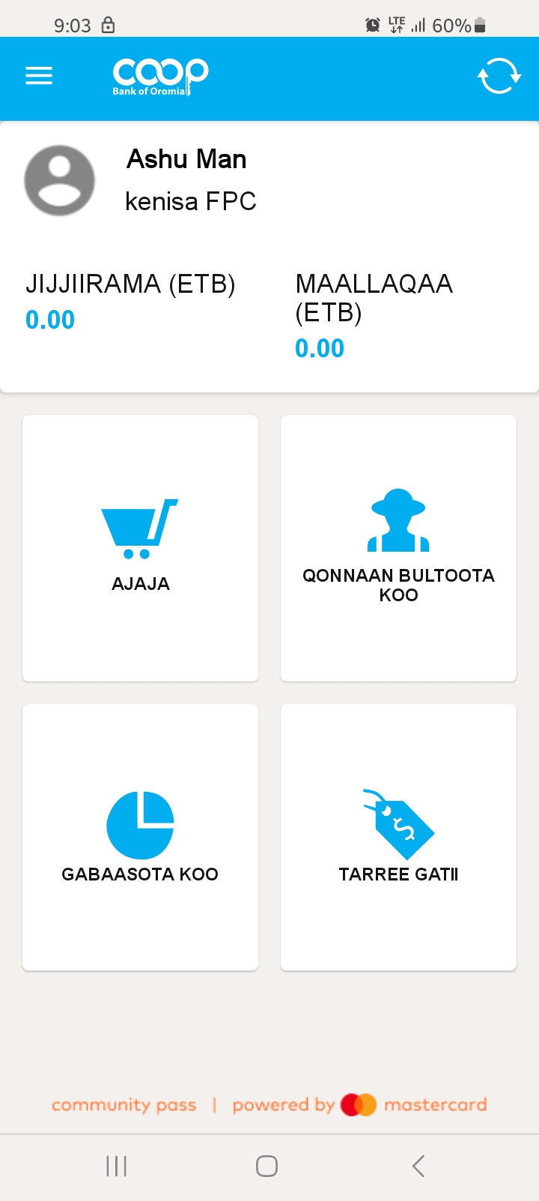

Farm Pass
Simple and Easy to Use platform
( Made Considering the Agri-sector)
Coopbank Farm pass - powered by Mastercard's renowned Community Pass platform, it is an Eco-system that seamlessly connects farmers, cooperatives, aggregators, buyers, agricultural input/service providers, financial institutions, and other service providers.
Offline Mobile App
Language support in :
Afaan Oromo
Amharic and
English
Web
&
* Farmers do not directly use the platform, they access it through their Cooperative, Cooperative Agents or any other organization they are under.
Empowering Communities, Transforming Lives!

Slide 2

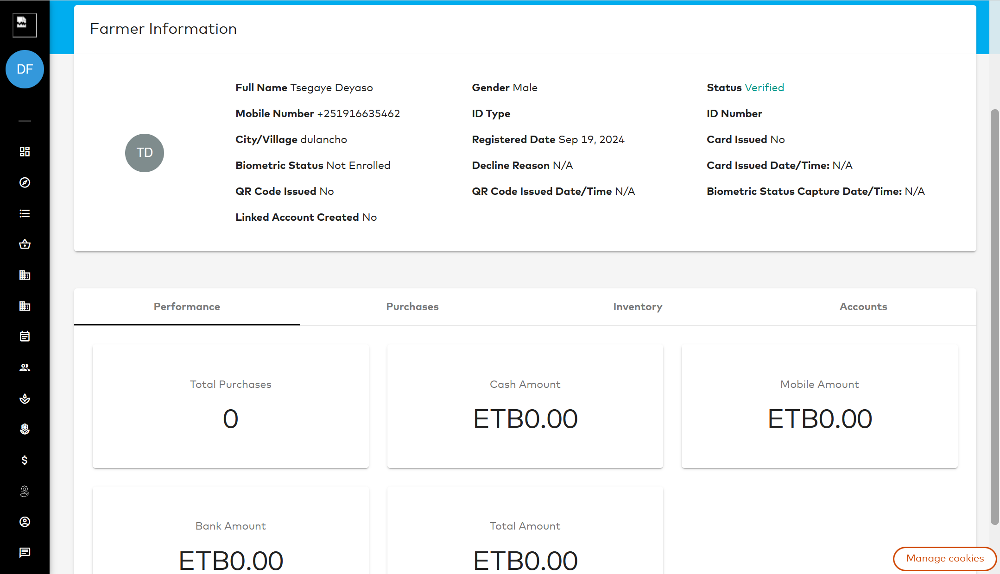
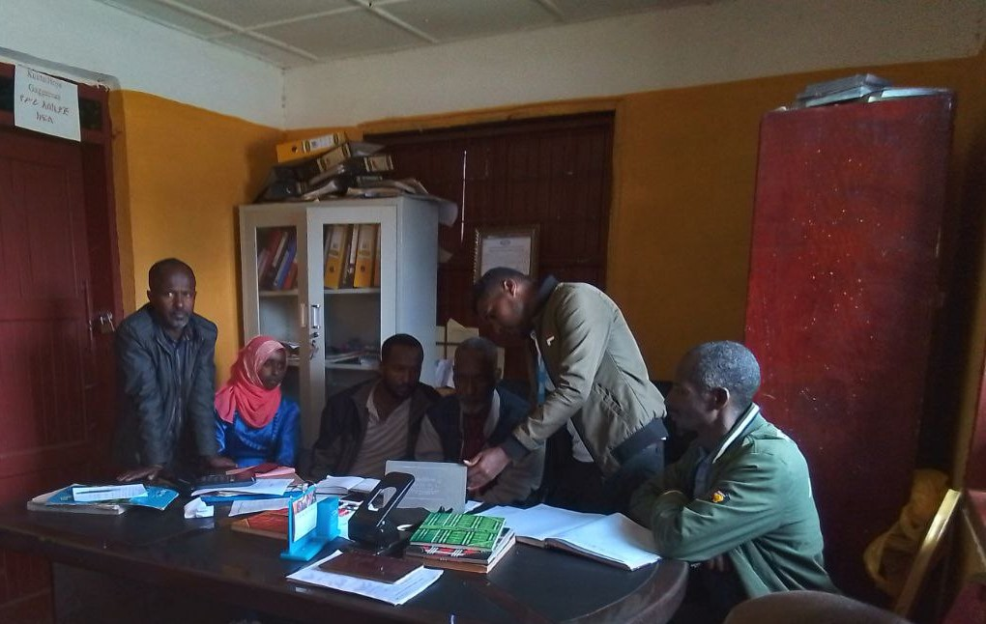
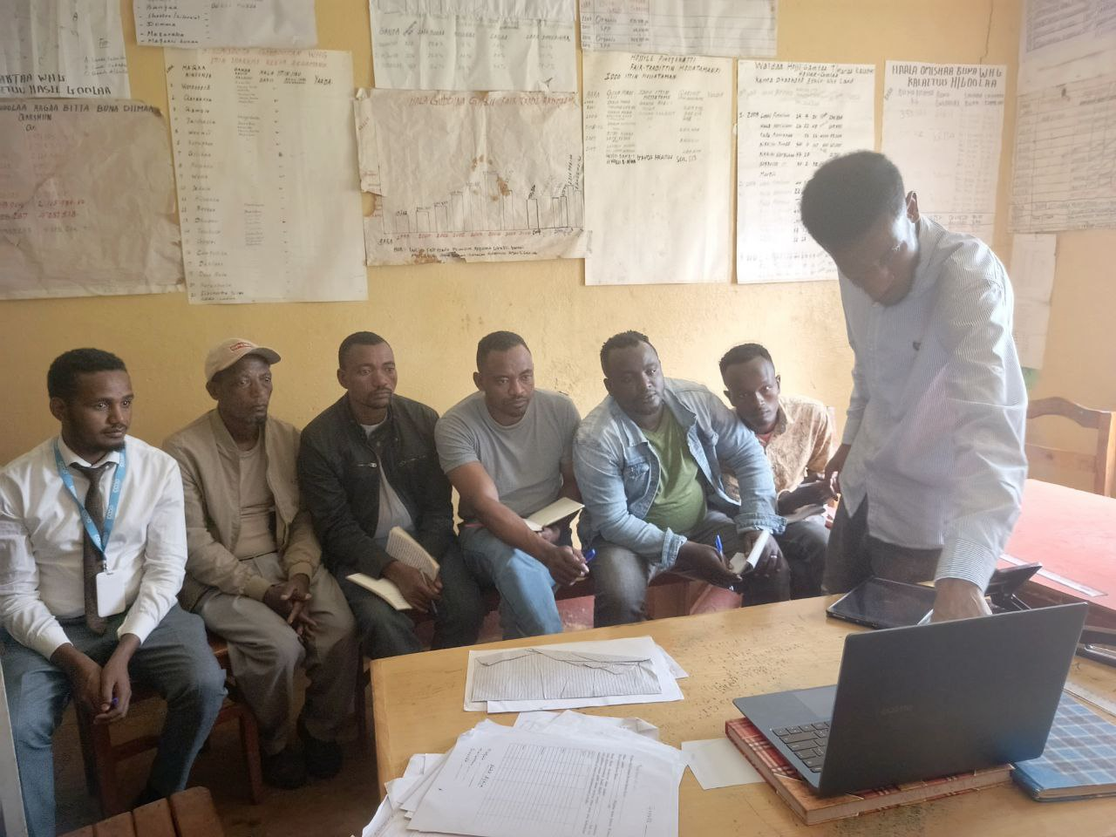
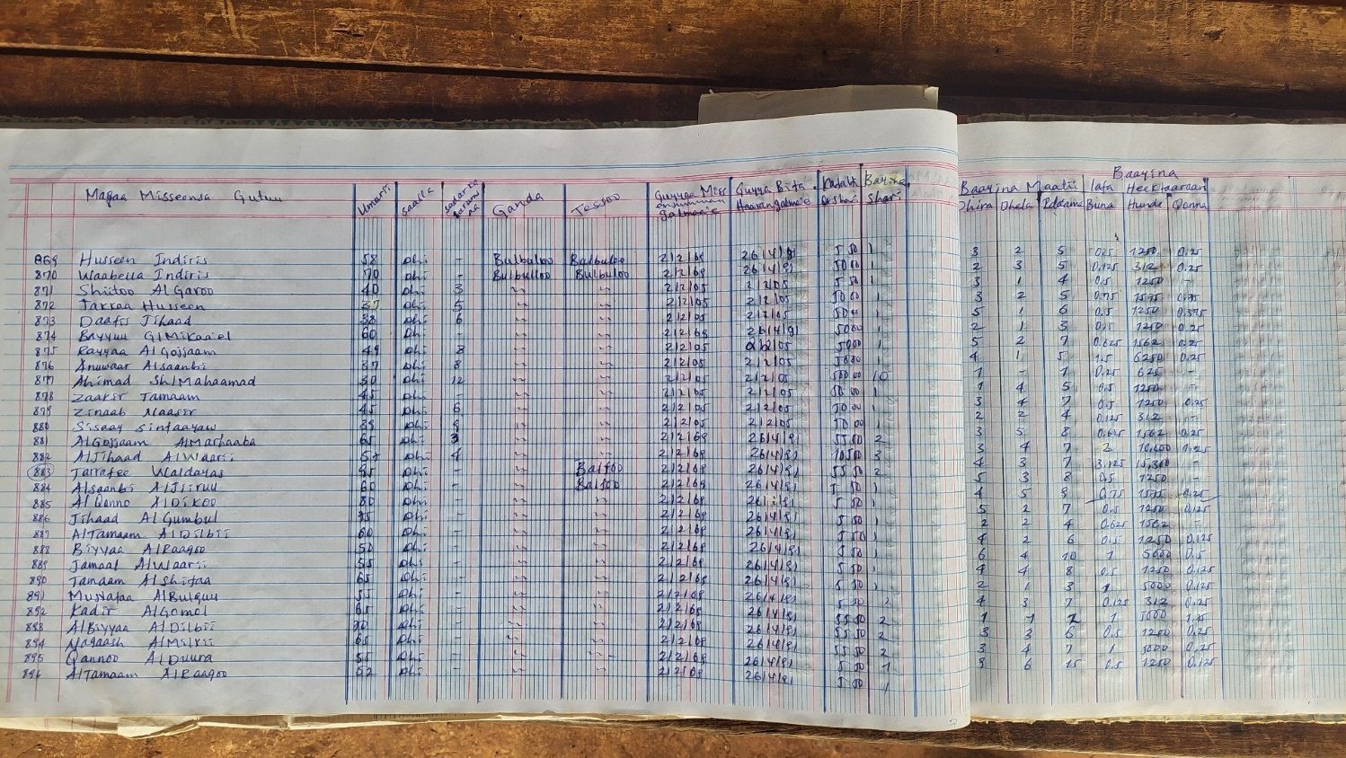
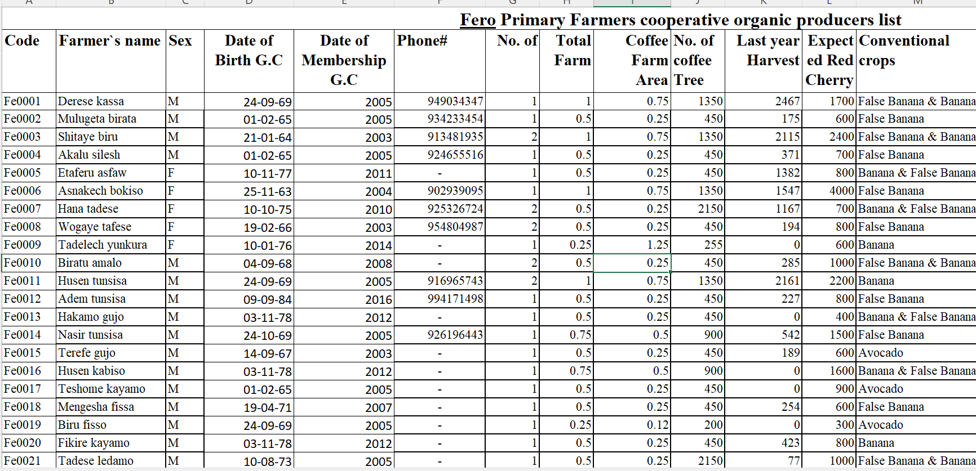
Farm pass Services
Farmer Profiling
Digitize Member Farmers Profile for Cooperatives
Enable Cooperatives to Communicate with their Farmers through SMS
Enable SMS based Advisory Services, Market Information, Weather Info and etc..
Empowering Communities, Transforming Lives!

Slide 3
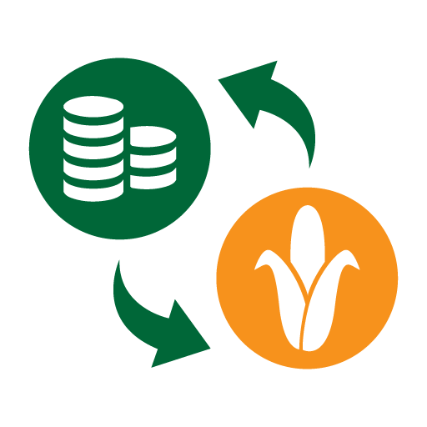




Farm pass Services
Better Access to Services
Farmers Service Demand Aggregation – Enable Cooperatives to aggregate and address input / Service needs of Farmers
Connecting Farmers with
Insurance Providers
Input Providers
Extension service providers
Agri Tech Companies
Financial Institutions and etc…
Farm pass
Ecosystem
Empowering Communities, Transforming Lives!

Slide 4


Farm pass Services
Better Access to Market with Ability to make Digital payments
Enable Secure Payments Between Aggregators , Buyers and Farmers.
Payments Offline with no connectivity
Produce Collection – Digitize Aggregation and Payments
Harvest Projection
Buyer order Management – Connecting Farmers, Cooperatives and Buyers Digitally.
Credit enablement / Financial Inclusion
Automate Loan Application and Approval for Farmers and Cooperatives
Enable Credit Scoring based loan for Agri sector Key actors
Empowering Communities, Transforming Lives!

Slide 5
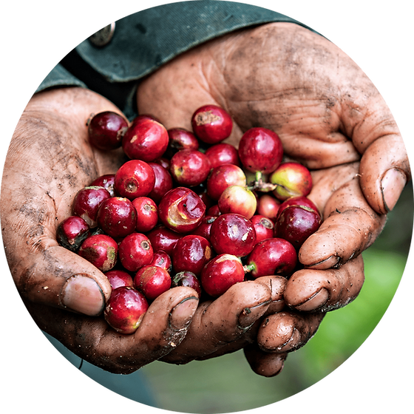
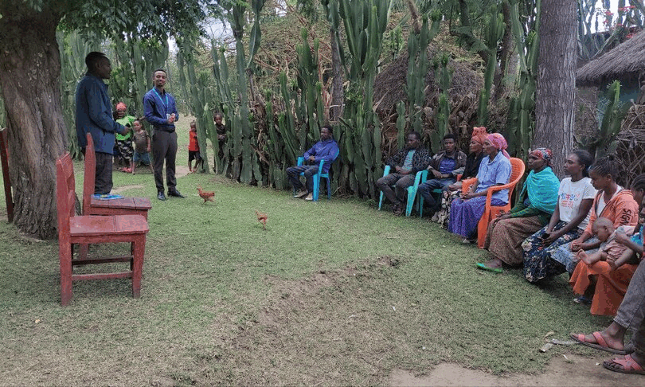
Farm pass
Current Status
Pilot Report
253,059 +
477 +
16 Primary cooperatives
11K Farmers
Coffee Value Chain
Oct – January 2024
Farmers Onboarded
Primary Cooperatives
Value Chains
Coffee
Wheat
Barley
Poultry
9,200+
Farmer to FPC Transactions Recorded
1.4 Million USD / 81 Million ETB
2 Million Kg of Coffee transactions digitized
Empowering Communities, Transforming Lives!

